Slide 1

US SECTOR PERFORMANCE BY MACRO REGIME SINCE 1955
Hans Heytens
hansheytens@hotmail.com
0032 469 19 22 26
For illustrative and educational purposes only. The code or the logic might contain errors. All mistakes remain the author's fault. If you find any, please let me know so I can rectify. Other feedback is most welcome.

Slide 2
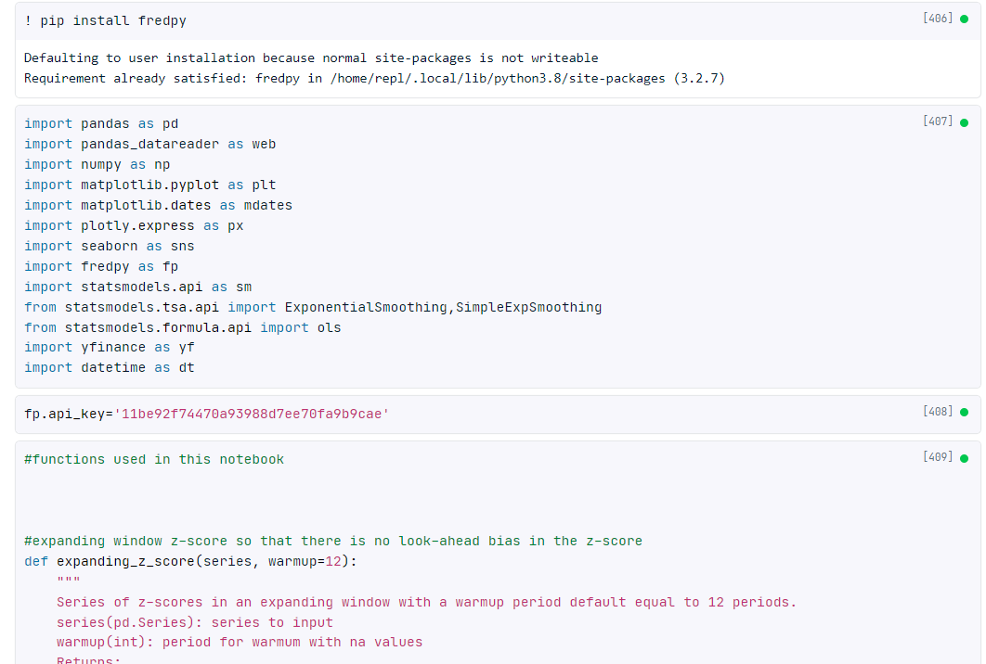
HYPERLINK TO PYTHON CODE
https://app.datacamp.com/workspace/w/c129a063-9871-43f1-82fe-2111c22851ff

Slide 3
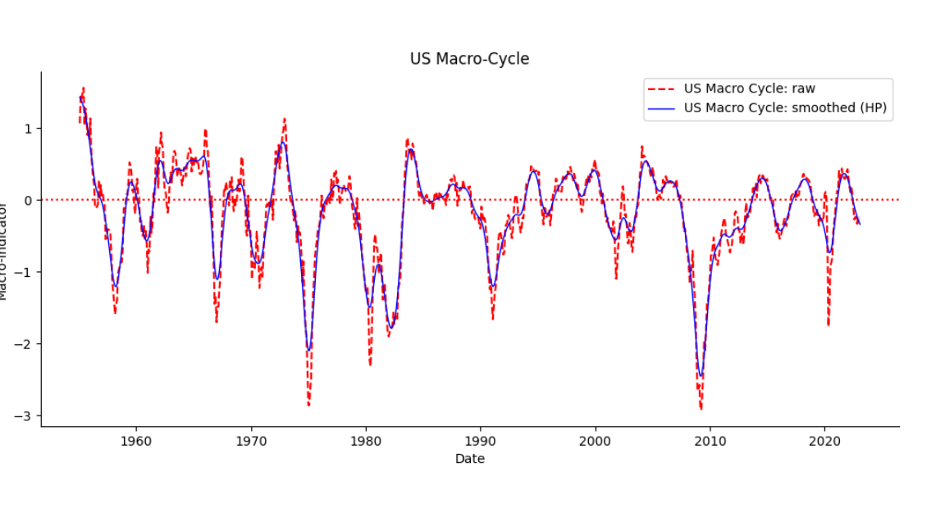
US MACRO INDICATOR BASED ON 11 VARIABLES*
*Variables: normalized, PCA-analysis to look for contribution, averaged and smoothed via HP-filter.
Composites: US Lei 6m, US OECD, US Chicago Fed Index
Market & monetary: Baa credit spread, 10-3m term spread
Production: ISM manufacturing, Manufacturing hours worked
Consumer: Michigan consumer confidence
Labor: Part-time employment for economic reasons, 4-week moving average of jobless claims
Housing: total units housing permits, total units housing starts

Slide 4
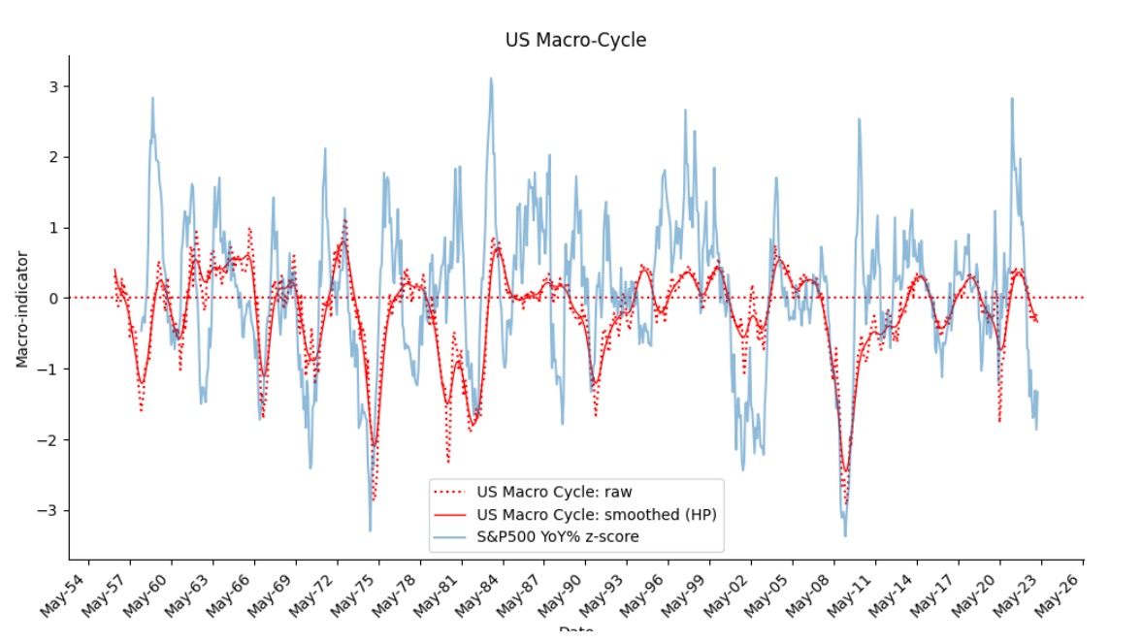
US MACRO INDICATOR VERSUS S&P500 YoY

Slide 5
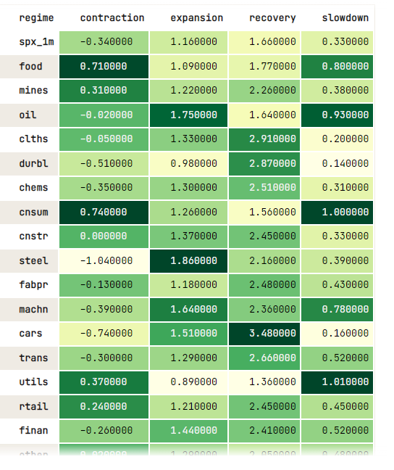
AVERAGE US INDUSTRY MONTHLY PERFORMANCE BY MACRO-REGIME
FamaFrench 17 industries database

Slide 6
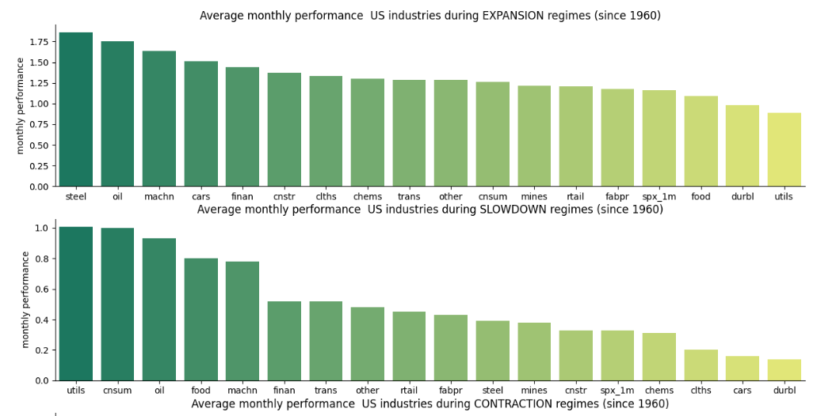
AVERAGE US INDUSTRY MONTHLY PERFORMANCE BY MACRO-REGIME

Slide 7
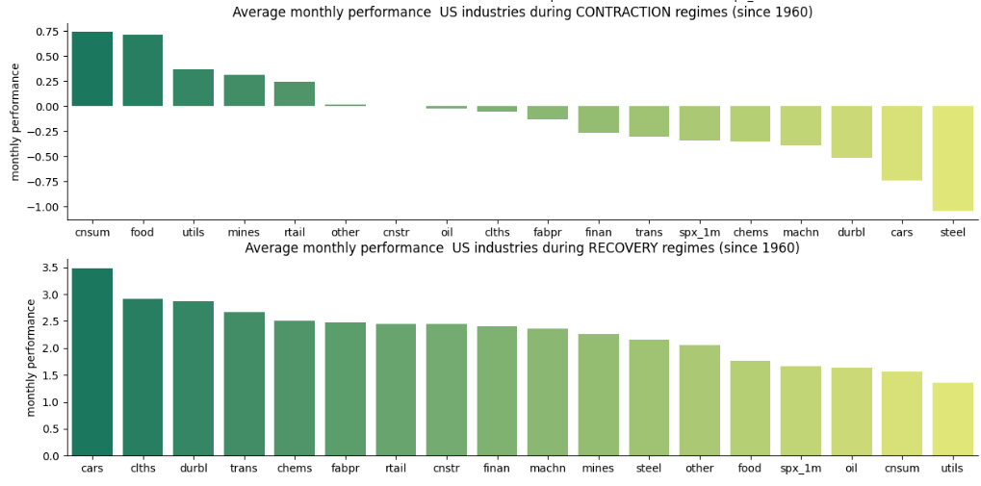
AVERAGE US INDUSTRY MONTHLY PERFORMANCE BY MACRO-REGIME

